Slide 1
Customer 360 Profile Enrichment

Slide 2
There are many variables in the formula for success in business. The most dynamic and important of these is customers. How well do you know your customers? This is a challenge for businesses everywhere. Customer 360 Profile Enrichment not only helps you know your customer better, but to predict their wants and needs.
One of the great advantages to the digital age is the wealth of data available to businesses about their customers. Hidden in that data is the answer to questions such as: “Who IS my customer?” and “What do they want or need?”. Customer 360 Profile Enrichment uses Machine Learning and data from virtually any source, and any format, to answer these questions by building informed, intelligent profiles that give valuable insight into customers. Enriched profiles can then be used in a multitude of solutions and strategies to improve operations and profit margins.

Slide 3
The Need for Customer 360 Profile Enrichment

Slide 4
81%
of marketers report having
challenges achieving a
single customer view
Source: Experian Digital Marketer Report 2016

Slide 5
Challenges in Leveraging Data for Customer Profiles
Unable to connect data sets
Expertise is unavailable
Tools are cost-prohibitive
Siloed organizations or departments

Slide 6
97%
of organizations are looking to
achieve a complete view of the customer

Slide 7
Implementing Customer 360 Profile Enrichment

Slide 8
Challenges in Implementing Customer 360 Profile Enrichment
Interpreting data and analyses…
…to find meaningful insight
Retrieving data…
…from multiple disparate sources
Leveraging insights…
…to enrich customer profiles
Accessing technology…
…to build customer profiles
Validating the solution…
…properly and accurately

Slide 9
Benefits
INCREASE Customer Retention
REDUCE Overall Costs
IMPROVE Sales/Revenue
BETTER Customer Experience
PREDICT Customer Behavior
IDENTIFY Future Prospects
Inform Strategic Decision-making

Slide 10
End-to-end Data Flow
Azure Data Factory
Coordinates data transfer between HDInsight and Azure Storage for profile enrichment.
Azure Stream Analytics
3. Aggregated browsing activity
Azure Storage
8. Visualize
Power BI
Ingests browsing activity from Azure Event Hub, aggregates it and delivers it to Azure Storage in near real-time.
Stores aggregated browsing activity, customer profiles merged with engineered features and enriched customer profiles with predicted purchases.
Creates reports and visualizations based on the aggregated data and results from HDInsight.
2. Queued browsing activity
4. Browsing data is transferred
5. Engineered features are returned
6. Scoring is transferred to HDInsight
7. Predicted purchases are returned
Azure Event Hub
This highly-scalable service ingests real-time browsing data.
HDInsight (Spark R Server)
Uses Python for ETL and R for Machine Learning. Creates engineered features and predicted purchases
1. Browsing activity
C
ON
T
M
OSO
A
R
T
C
Azure SQL Data Warehouse
ON
T
M
A
OSO
R
T
C
ON
T
OSO
M
A
R
T
Stores referential data such as demographics, purchases, products and enriched customer profiles to be ingested by HDInsight for future profile enrichment
8. Enriched customer profile (external table)

Slide 11
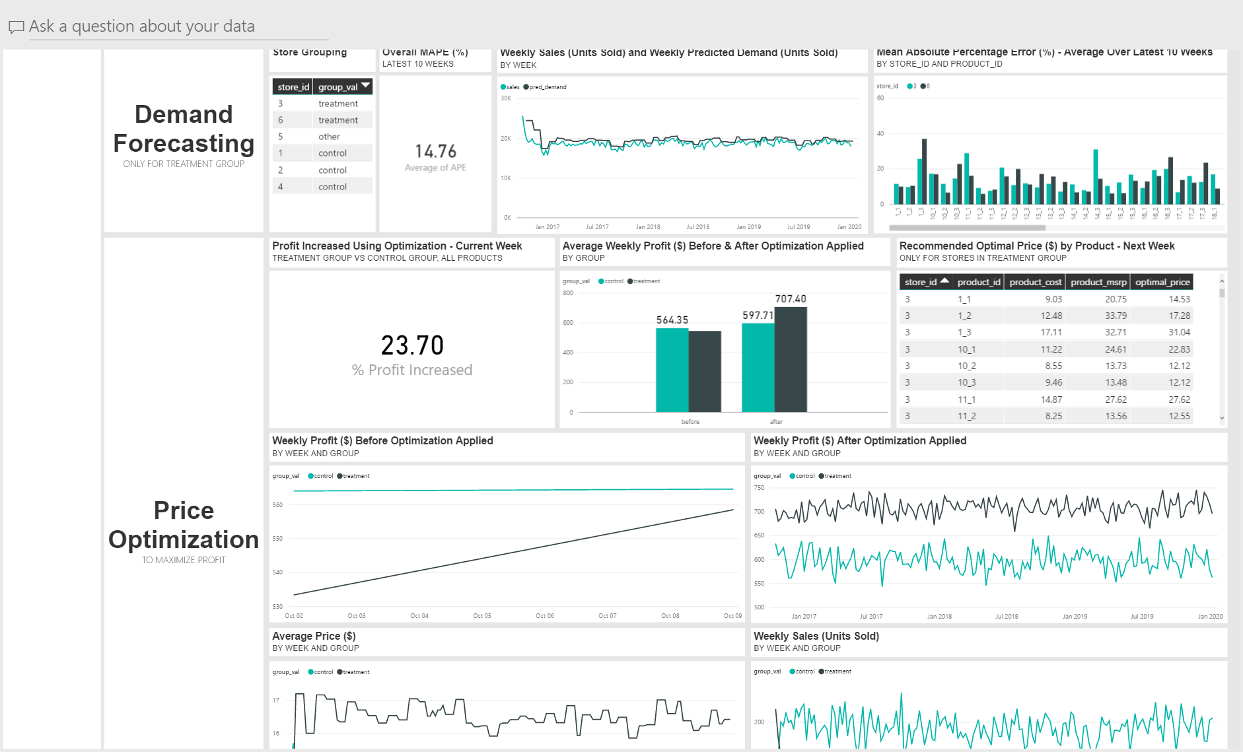
Sample Dashboard

Slide 12
Cortana Intelligence Suite

Slide 13
Cortana Intelligence Suite | Overview
Cortana Intelligence is a fully managed big data and advanced analytics suite in the cloud that transforms data into intelligent action.
Cortana Intelligence…
Allows you to collect, manage, process and store all your data that can seamlessly and cost effectively grow over time in a scalable and secure way.
Provides easy and actionable analytics powered by the cloud that allow you to predict, prescribe and automate decision making for the most demanding problems.
Enables intelligent solutions through cognitive services and agents that allow you to see, hear, interpret and understand the world around you in more contextual and natural ways.

Slide 14
Cortana Intelligence Suite | Advantages
COST
SCALABILITY
GROWTH
There are no upfront costs or COGS (Cost of Goods Sold) component costs associated. Meaning there is no need to invest in hardware, software, and/or IT maintenance. This translates into a substantial reduction in business risk.
Servers for computing and/or storage can be deployed and scaled on an as-needed basis and can be done quickly and easily. This effects the cost efficiency advantage of a cloud-based solution with a pay-for-what-is-used policy.
Features, components, and capabilities are consistently being introduced and evolved in Cortana Intelligence Suite. As such, they can easily and quickly be implemented in a cloud-based solution.

Slide 15
Cortana Intelligence Suite | Overview
Information Management
Big Data Stores
Machine Learning and Analytics
Intelligence
Data Sources
People
Data Factory
Data Lake Store
Machine Learning
Cognitive Services
Data Catalog
SQL Data
Warehouse
Data Lake Analytics
Bot Framework
Web
Apps
Event Hubs
HDInsight
Cortana
Mobile
Apps
Stream Analytics
Bots
Dashboards & Visualizations
Sensors and Devices
Power BI
Automated Systems
Data
Intelligence
Action

Slide 16
Appendix

Slide 17
Cortana Intelligence Suite | Used in this Solution
HDInsight
HDInsight allows you to easily spin up enterprise-grade open source cluster types guaranteed with the industry’s best 99.9% SLA and 24/7 support. We guarantee this SLA for the entire big data solution, not just the VM instances. HDInsight is architected for full redundancy and high availability including head node replication, data geo-replication, and built-in standby NameNode making HDInsight resilient to critical failures not addressed in standard Hadoop implementations. Azure also offers cluster monitoring and 24x7 enterprise support backed by Microsoft and Hortonworks with 37 combined committers for Hadoop core, more than all other managed cloud providers combined to support your deployment and the ability to fix and commit code back to Hadoop.

Slide 18
Cortana Intelligence Suite | Benefits
Cortana Intelligence Suite enables you to realize your business outcomes by providing tools to transform data into intelligent action. It transforms entire systems of production, management and governance by enabling you to reap business benefits such as:
Improve visibility and prediction accuracy
Get the right products to the right places efficiently
Offer customers exactly what they want, when they want it
Fix problems proactively before they start
Capture new business opportunities
Use Cortana Intelligence Suite to improve outcomes and solve challenges across all aspects of your business.

